Slide 1
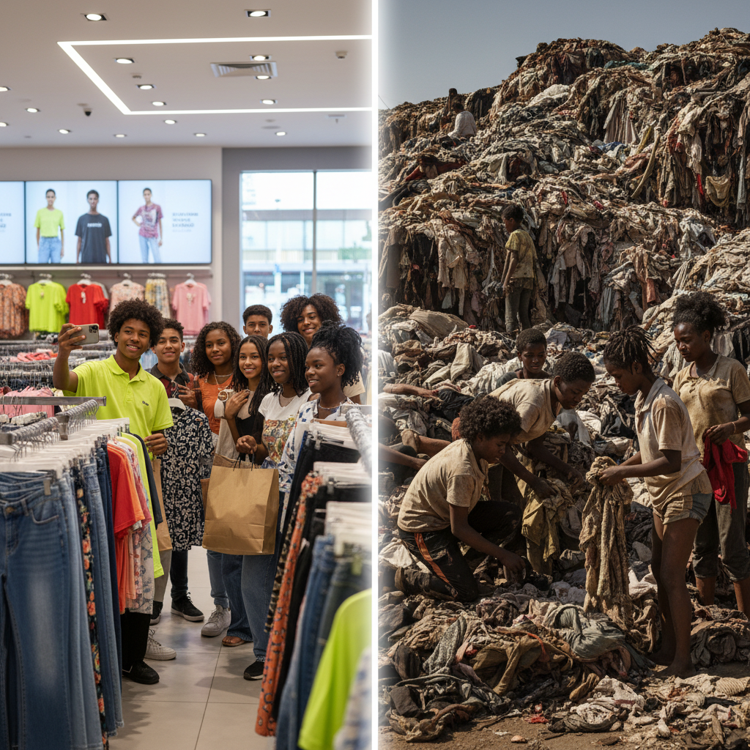
ModelIt!
Student Lesson
Fast Fashion Is Killing the Planet
Modeling the Environmental Cost of Cheap Clothing
NGSS: HS-ESS3-4, HS-ETS1-3
9th Grade — Level 1: Foundations
1/9

Slide 2
What You Will Learn Today
Learning Goals
* Model how consumer demand for cheap clothing drives a cycle of overproduction, waste, and environmental destruction
* Explain the relationships between production rate, textile waste, water consumption, and carbon emissions in the fashion industry
* Predict the environmental consequences of current fast fashion trends continuing over the next decade
* Evaluate technological and behavioral solutions that could reduce the fashion industry's environmental footprint
Key Vocabulary
Fast Fashion
A business model based on rapidly producing large volumes of trendy clothing at low cost, encouraging consumers to buy frequently and discard quickly — brands like Shein, H&M, and Zara release thousands of new styles weekly
Textile Waste
Discarded clothing and fabric that ends up in landfills or incinerators — the average American throws away 81.5 pounds of clothing per year, and globally 92 million tons of textile waste is generated annually
Water Footprint
The total volume of fresh water used in the production of goods — a single cotton T-shirt requires approximately 2,700 liters of water to produce, equivalent to one person's drinking water for 2.5 years
Carbon Footprint
The total greenhouse gas emissions caused by manufacturing, transporting, and disposing of a product — the fashion industry produces 10% of global carbon emissions, more than international flights and maritime shipping combined
2/9

Slide 3

The Big Question
How does a $5 T-shirt end up costing the planet so much?
Modeling the Environmental Cost of Cheap Clothing. Today we'll build a MODEL to discover the answer!
3/9

Slide 4

Today We Will Build a Model!
A model helps us understand complex systems!
1. LOCATE
Identify the COMPONENTS (parts) of the system
2. ESTABLISH
Connect them with RELATIONSHIPS (+ or -)
3. VISUALIZE
Build your model in ModelIt!
4. EVALUATE
Run SIMULATIONS to test scenarios
5. REVISE
Improve your model based on evidence
4/9

Slide 5

Activity 1: Sort the Components
Sort these components into EXTERNAL (inputs from outside) and INTERNAL (inside the system):
Your Components:
* Consumer Demand
* Production Rate
* Textile Waste
* Water Consumption
* Carbon Emissions
Think: Which components can we control? Which happen on their own?
5/9

Slide 6
Activity 2: Connect with Arrows
Draw arrows to show HOW components affect each other:
(+) POSITIVE Relationship
When one goes UP, the other goes UP too
(-) NEGATIVE Relationship
When one goes UP, the other goes DOWN
Think About It:
When Consumer Demand increases because of a new social media trend, what chain reaction does it trigger through Production Rate, and how does that amplify Textile Waste, Water Consumption, and Carbon Emissions simultaneously?
6/9

Slide 7
Activity 3: Run the Simulation!
Test these scenarios in ModelIt!
Current Trends Continue
Set Consumer Demand to high (current levels) — observe the environmental outputs of the fast fashion system
Conscious Consumer Shift
Reduce Consumer Demand by 50% simulating a buy-less movement — observe how environmental outputs respond
Circular Fashion Model
Maintain Consumer Demand but add recycling and extend garment lifespan — observe whether technological solutions can offset high demand
Watch the activity graphs change!
[ModelIt Platform Screenshot - Simulation Results Graph]
7/9

Slide 8
What Did We Discover?
Our Model Showed Us:
* Consumer demand is the primary driver — every additional garment purchased triggers water consumption, carbon emissions, and eventual textile waste in a one-directional cascade
* The fast fashion system produces environmental damage at every stage: growing raw materials (water), manufacturing (carbon), shipping (carbon), wearing (microplastics), and disposal (landfill waste)
* Reducing demand has a larger environmental impact than improving recycling, because most environmental damage occurs during production, not disposal
* The fashion industry's environmental impact is hidden from consumers — the true cost of a $5 T-shirt includes 2,700 liters of water, 7 kg of CO2, and eventual landfill space for 200+ years
Answer: A $5 T-shirt costs the planet enormously because the price tag hides the true environmental cost. Consumer demand for cheap, trendy clothing drives manufacturers to produce at breakneck speed using enormous quantities of water (2,700 liters per shirt), generating massive carbon emissions (10% of global total), and creating 92 million tons of textile waste annually. The model reveals a one-directional cascade: consumer demand drives production rate, which simultaneously increases water consumption, carbon emissions, and textile waste. The system is designed to be disposable — and the planet pays the hidden price.
8/9

Slide 9

STEM Challenge: Design a Sustainable Fashion Solution
YOUR ENGINEERING MISSION
Design a business model, technology, or system that reduces the environmental footprint of the clothing industry while remaining economically viable and appealing to teenage consumers.
The Challenge:
A major clothing retailer wants to become more sustainable but can't afford to lose teenage customers. They've hired your team to design a solution — whether it's a new material, a recycling system, a rental service, or a completely new business model — that dramatically reduces water, carbon, and waste while keeping clothes affordable and trendy.
Think Like an Engineer:
* What stage of the fashion supply chain causes the most environmental damage, and how would your solution target it?
* How would you make sustainable fashion cool enough that teenagers actually choose it over fast fashion?
* What trade-offs would your solution require, and are they acceptable?
REAL CAREER CONNECTION: Environmental Engineers design systems to reduce industrial pollution and waste, earning $65,000–$130,000/year. Sustainable Fashion Designers create clothing using eco-friendly materials and ethical production methods, working at brands like Patagonia, Eileen Fisher, and Stella McCartney, earning $50,000–$120,000/year. The skills you're using TODAY are the same ones they use on the job!
9/9

